Slide 1
Virtual Methods and Inheritance
C# Tutorial

Slide 2
Contents
By the end of this tutorial you should understand:
  Simple Inheritance
  How to override inherited methods
  How to control overriding using virtual methods

Slide 3
Inheritance
Classes may ‘inherit’ members from another class.
Terms:
  A class inheriting members is ‘derived’ from a ‘base class’.
  The class providing members to the ‘derived class’ is its ‘base class’.
A derived class may be referred to in terms of its base class.
A class may inherit from one base class.
The base class may itself be a derived class.
Many classes may derive from the same base class.

Slide 4
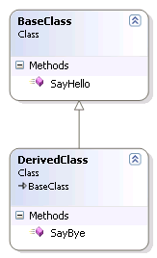
Inheritance
public class BaseClass
{
public void SayHello()
{
Console.WriteLine("Hello World from BaseClass.");
}
}
public class DerivedClass : BaseClass
{
public void SayBye()
{
Console.WriteLine("Goodbye World from DerivedClass.");
}
}

Slide 5
Inheritance
DerivedClass now provides two methods:
  SayHello()
  SayBye()

Slide 6
Inheritance
BaseClass baseClass = new BaseClass();
baseClass.SayHello();
Will write the following to the screen:
Hello World from BaseClass.
DerivedClass derivedClass = new DerivedClass();
derivedClass.SayHello();
derivedClass.SayBye();
Will write the following to the screen:
Hello World from BaseClass.
Goodbye World from DerivedClass.
BaseClass derivedClassAsBaseClass = new DerivedClass();
derivedClassAsBaseClass.SayHello();
Will write the following to the screen:
Hello World from BaseClass.

Slide 7
Override
Inherited methods may be replaced (overridden).
Use the override keyword in C#.
When referring to a derived class in terms of its base class, the overridden method in the derived class will be invoked.
(this is the opposite of the ‘new’ keyword in a method signature)
Only virtual or abstract methods can be overridden.
A method can be re-overridden in each class that inherits it.

Slide 8
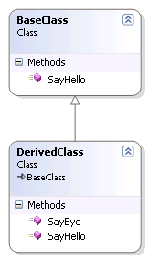
Override
This will not compile:
'DerivedClass.SayHello()': cannot override inherited member
‘BaseClass.SayHello()'
because it is not marked virtual, abstract, or override
public class BaseClass
{
public void SayHello()
{
Console.WriteLine("Hello World from BaseClass.");
}
}
public class DerivedClass : BaseClass
{
public void SayBye()
{
Console.WriteLine("Goodbye World from DerivedClass.");
}
  public override void SayHello()
  {
  Console.WriteLine("Hello World from DerivedClass.");
  }
}

Slide 9
Virtual Methods
Used to identify methods which may be overridden.
Indicated with the virtual keyword.
Security feature not available in many object orientated languages (e.g. Java).
  Advantage: Makes clear where overriding is appropriate and prevents inappropriate overrides.
  Drawback: You have to consider whether each method should allow overrides.
Method declared virtual once, before the first override (overridden definitions can be subsequently overridden).

Slide 10
Virtual Methods
public class BaseClass
{
public virtual void SayHello()
{
Console.WriteLine("Hello World from BaseClass.");
}
}
public class DerivedClass : BaseClass
{
public void SayBye()
{
Console.WriteLine("Goodbye World from DerivedClass.");
}
  public override void SayHello()
  {
  Console.WriteLine("Hello World from DerivedClass.");
  }
}

Slide 11
Virtual Methods
BaseClass baseClass = new BaseClass();
baseClass.SayHello();
Will write the following to the screen:
Hello World from BaseClass.
DerivedClass derivedClass = new DerivedClass();
derivedClass.SayHello();
derivedClass.SayBye();
Will write the following to the screen:
Hello World from DerivedClass.
Goodbye World from DerivedClass.
BaseClass derivedClassAsBaseClass = new DerivedClass();
derivedClassAsBaseClass.SayHello();
Will write the following to the screen:
Hello World from DerivedClass.

Slide 12
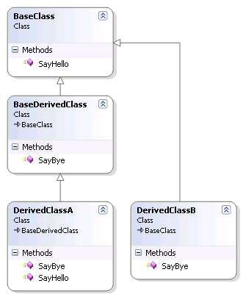
Example
public class BaseClass
{
public virtual void SayHello()
{
Console.WriteLine("Hello World from BaseClass.");
}
}
public class BaseDerivedClass : BaseClass
{
public virtual void SayBye()
{
Console.WriteLine("Goodbye World from BaseDerivedClass.");
}
}
public class DerivedClassA : BaseDerivedClass
{
public override void SayBye()
{
Console.WriteLine("Goodbye World from DerivedClassA.");
}
public override void SayHello()
{
Console.WriteLine("Hello World from DerivedClassA.");
}
}
public class DerivedClassB : BaseClass
{
public void SayBye()
{
Console.WriteLine("Goodbye World from DerivedClassB.");
}
}

Slide 13
Questions
What would be printed to the console for the following:
DerivedClassA myClass = new DerivedClassA();
myClass.SayHello();
DerivedClassB myClass = new DerivedClassB();
myClass.SayHello();
BaseClass myClass = new DerivedClassA();
myClass.SayHello();
BaseClass myClass = new DerivedClassA();
myClass.SayBye();

Slide 14
Answers
Hello World from DerivedClassA.
Hello World from BaseClass.
Hello World from DerivedClassA.
Nothing – BaseClass does not implement a SayBye() method.

Slide 15
Consider
Describe how virtual methods and inheritance could be used to derive a ‘cube’ class from a ‘square’ class both of which provide a GetSurfaceArea() method?
Tip: The surface area of a cube is 6 times the area of a square.

Slide 16
Further reading
Referring to a base class using the ‘base’ keyword.
Method hiding using the ‘new’ keyword.
How to override properties.
Abstract classes and members.

Slide 17
Source code
The source code for this tutorial is available at:
www.hull.ac.uk\~php\csprp\not_a_real_site

